Slide 1








Baseline: FLE Paper 2 - Writing Paper
Section B: Composition Writing
WWW (What Went Well)
Even Better If (EBI)
Has some effective images
Some pictures and descriptions
Some precise vocabulary and sentence structure
A selection of relevant ideas
Unnatural phrasing and mismatched contexts
Develop the images you are describing with more details
Explain context instead of repeating what is there
Focus on building a convincing image
Use similes, metaphors, and onomatopoeia
September 4th, 2026

Slide 2
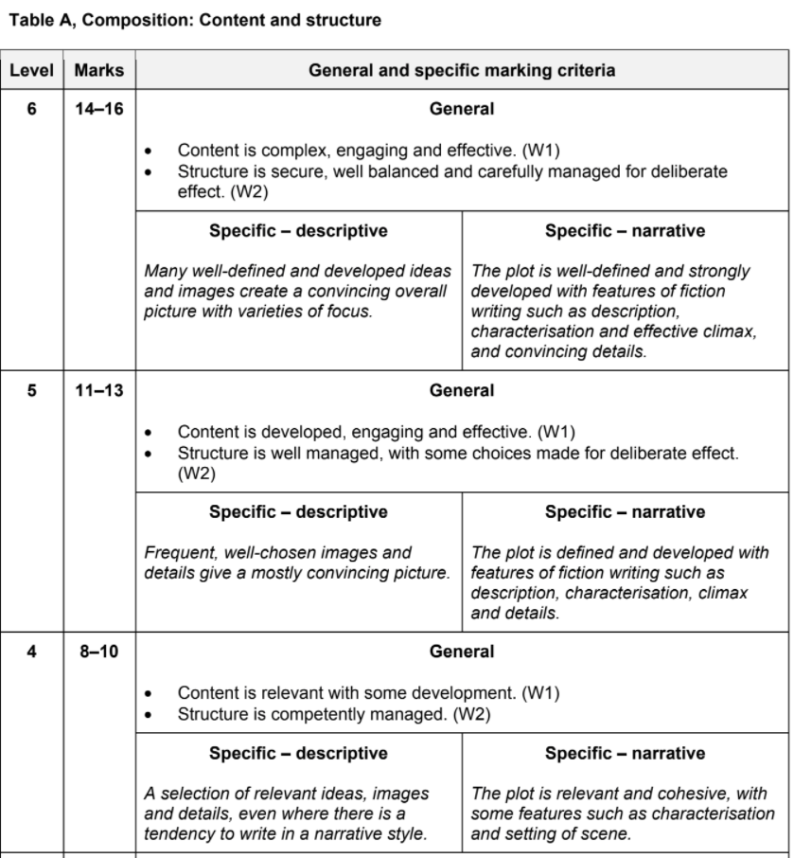
EBI:
Narrative:
Need to clearly write and structure the 6 components of a story mountain
Falling action, and resolution need to be developed. Cannot end story on only a climax
EBI:
Descriptive:
Stronger focus on question prompt is needed
Zoom-in on details that focus on the prompt question after establishing a dominant impression
Target

Slide 3
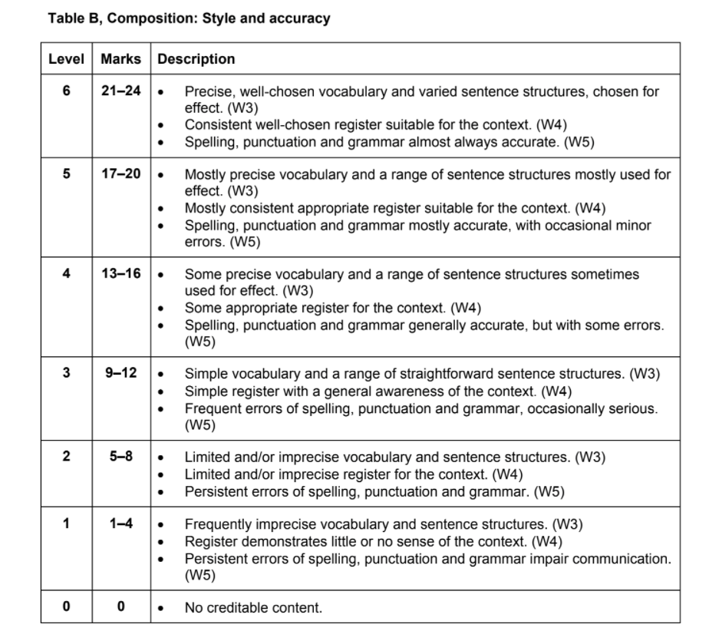
EBI:
Narrative:
Need to use more devices from A FOREST, there was a heavy focus on dialogue
EBI:
Descriptive:
Organisation of ideas that support the prompt question
SPAG (Grammar in particular) – run-on sentences, fragmented sentences, incomplete sentences
Target
Notes:
2 mins to show and focus more on this next lesson

